Slide 1
A User Interface for Circuit Design
How do we want our application to look? To feel?

Slide 2
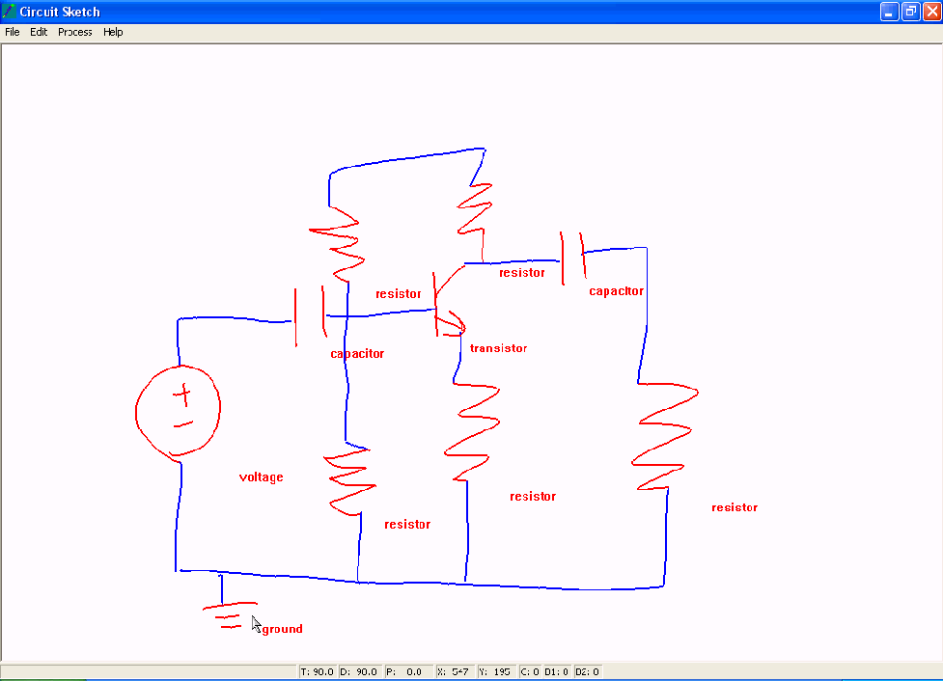
A User Interface for Circuit Design
AC-SPARC

Slide 3
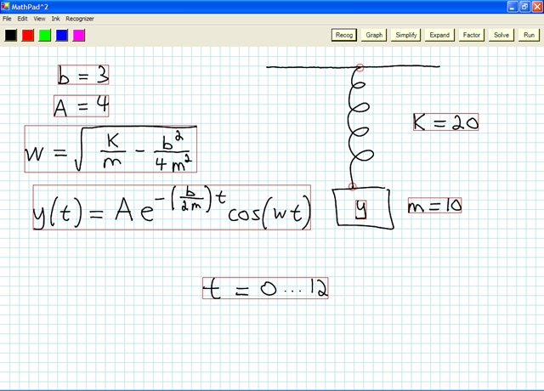
A User Interface for Circuit Design
MathPad²

Slide 4
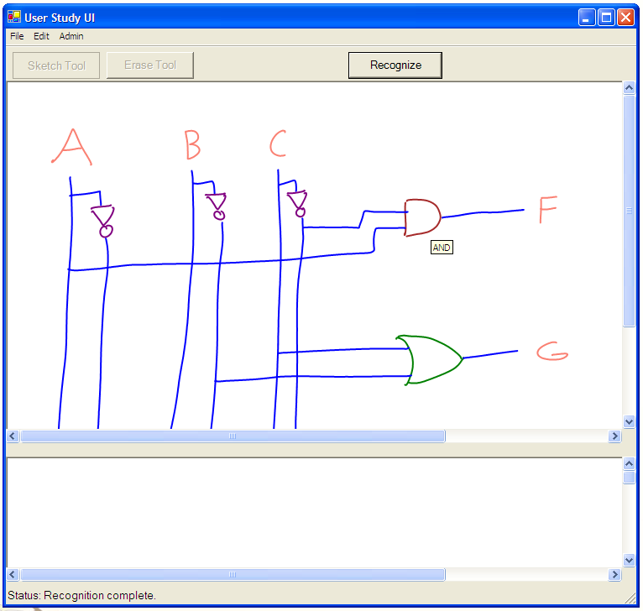
A User Interface for Circuit Design
Our Prototype

Slide 5
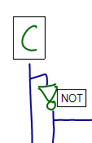



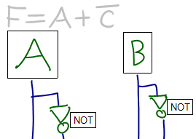
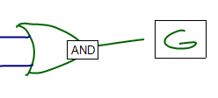
Study of User Interface Elements
Recognition Triggers
Feedback Mechanisms
Annotation Tools
Error Types

Slide 6
Experiment Design
User Domain Analysis
  Truth table tasks
Iterative Software Development
  Study subsets of interface elements
  Identify additional features to test
Observables
  Qualitative user feedback
  Survey results

Slide 7

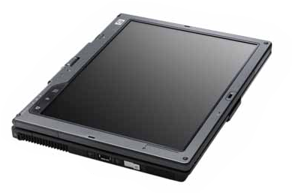
Wizard of Oz Methodology
User Machine
User Draws Circuit
Network
Connection
Wizard Machine
Wizard Simulates
Recognition

Slide 8
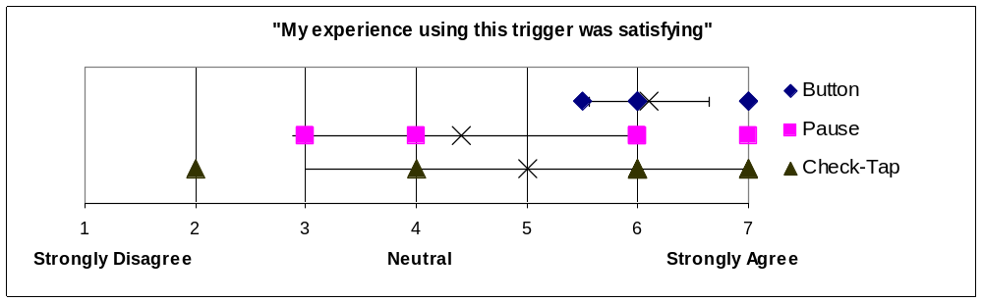
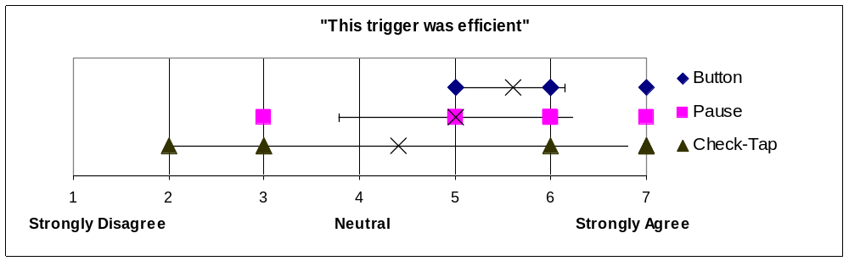
Results: Recognition Triggers

Slide 9
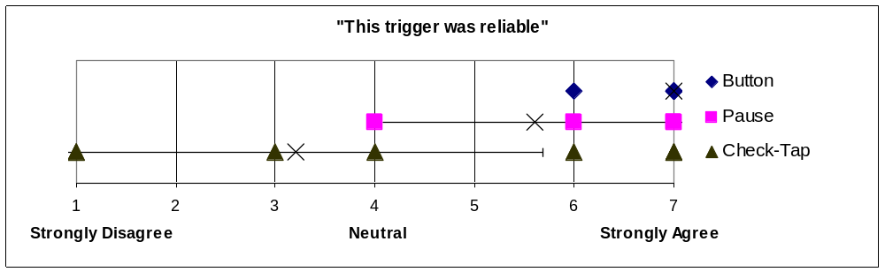
Results: Recognition Triggers
(Check-Tap Gesture: 1 in 5 success rate)

Slide 10
Results: Annotation Tools
(charts forthcoming)
Color tool wins in efficiency and comfort
Color is ranked 1st unanimously
users prefer pre-separation tool that requires the least amount of effort

Slide 11
Results: Feedback Mechanisms
(charts forthcoming)
Color feedback is slightly more understandable than text.
Text is a little more distracting than color.
But almost everybody preferred working with color.
No student suggested that learning the color scheme would be an unacceptable hardship; students tend to prefer their sketch undergoes minimal visual transformation unless the prompt the system for such transformation.

Slide 12
Results: Error Types
(charts forthcoming)
Recall demo of 3 errors
Show that surveys didn’t disambiguate the difficulties of errors
The crux of the matter:
  the more predictable errors are, the less accurate recognition must be. Omission and mislabel errors were likely the most confusing because they were randomly distributed; not synthesized by the wizard.
  The more powerful the correction or debugging mechanisms, the better. Suggestion: provide tool for viewing meshes (“what really matters is if your gates are connected”)
  Safer is better. Saying “I don’t know what this is” is better than mislabeling something. Omission errors are easier to detect than mislabel errors. Only labeling symbols with high probability and then actively training on the user’s corrections is perhaps the best strategy.

Slide 13
Future Work
Build it!
List of other features/ideas

